Slide 1
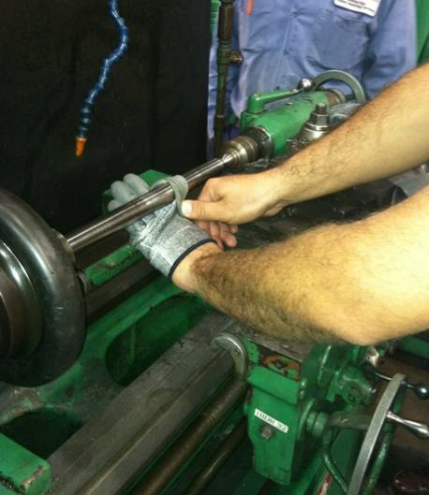
HS&E INCIDENT BULLETIN |  | 2nd Quarter 2012
Type of Incident: | Fracture
Summary:
While polishing a dowel pin chucked in a small tool-making lathe (Monarch), the machinist’s glove was caught around the part injuring his hand. The machinist was wearing cut-resistant gloves with anti-slip coating while polishing. The machinist was using a small, folded strip of emery cloth wrapped around the part with the ends pinched in his fingers. As he worked the cloth back and forth with the part rotating, he inadvertently allowed his left hand to contact the part. The part grabbed the thumb of his glove and pulled his hand into and around the part.
Root Causes: | Actions Taken Thus Far: Next Steps
1. Wearing gloves near rotating element. Coincidentally, the topic of properly polishing rotating parts was discussed in the previous night’s daily safety meeting. The importance of not wearing gloves and using sufficiently long sandpaper was reiterated. 2. Non-slip coating on gloves increased grip. 3. Too short of a strip of emery cloth. Did not provide sufficient separation from part. 4. Emery cloth folded so that there was abrasive on both sides increasing friction with finger. 5. Machinist moving his hand too close to part. 6. First time manufacture of this particular part although it was a simple dowel pin. 7. JSEA in place located at machine. Recently updated on 2/11/2012 and indicates injured employee as approved operator. 8. Night shift operator had not review new JSEA but old JSEA in place. 9. Employee reportedly was wearing gloves during machining due to hot chips hitting his hand. Employee was not using a chip guard. 10.Employee acknowledges he should have removed | 1. Safety Stand-Down planned for next morning • Reiterate rotating equipment and D-R “Hands Off” Directive. • Reinforce proper polishing techniques maintaining a safe distance from part. • Glove use around rotating parts 2. Disciplinary Action to be determined 3. Safety Department Interaction • Corporate HSE onsite the evening of the accident and lead this initial investigation reported here.

